Slide 1
Subject: SOFTWARE ENGINEERING Subject Code: 3CS4-07 UNIT I: Introduction to Software Engineering Lecture-2: SDLC Models
GLOBAL INSTITUTE OF TECHNOLGY JAIPUR
Software Engineering
III SEM CS

Slide 2
Sdlc (software life-cycle models)
SDLC stand for “SOFTWARE DEVELOPMENT LIFE CYCLE”.
It represents number of identifiable stages under which software goes during its life.
It is a diagrammatically representation which also provide description of various phases and their sequence in life cycle of software product.
Software undergoes basic stages during its life cycle i.e. requirement analysis and specification, design, coding and maintenance.
We have different SDLC models, each one have its own advantage and disadvantage
on the basis of:
Development speed
Product Quality
Project Visibility
Risk Exposure
Administrative overhead

Slide 3
Types of sdlc
There are many software development life-cycle models as there is no general agreement about various phases and their sequence in product life cycle. Some most commonly used life cycles models are given :
i. Waterfall model
ii. Prototype model
iii. Spiral model
iv. Evolutionary development model
v. Iterative enhancement model

Slide 4
Sdlc: waterfall models
It is a theoretical software development model.
It is developed by BOEHM in 1970.
It is also known as classical,traditional, conventional or linear segment model.
There are different stages to the development and the output of first stage flow to the next stage and so on.
It force on sequential phase
development in which no phase can overlap another phase.
Each phase of this model is well define the starting and ending criteria which is to be documented by which the standard outputs produce by each phase can formulate.

Slide 5
Phases of Waterfall modelS
Phases of Waterfall model: All work flows from communication towards deployment in a reasonably linear fashion.
Communication: includes project initiation and requirements gathering activities.
Planning: includes estimating, scheduling and tracking activities.
Modeling: includes analysis and design activities.
Construction: includes coding and testing activities.
Deployment: includes product delivery, support and feedback activities.

Slide 6
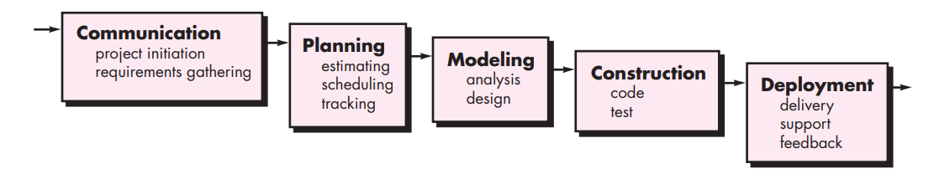
Generic Waterfall Model

Slide 7
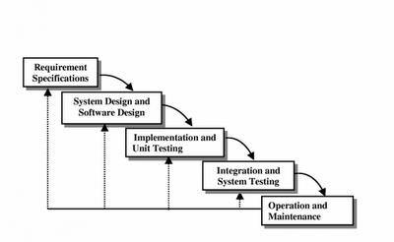
Iterative Waterfall Model

Slide 8
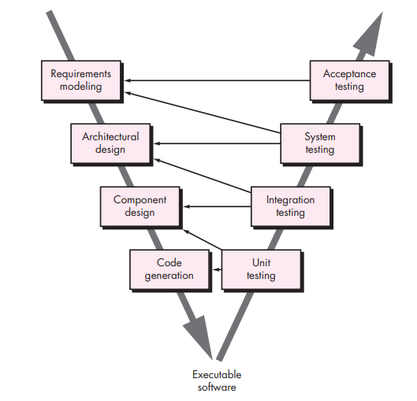
THE V-MODEL
A variation in the representation of the waterfall model is called the V-model. Represented in Figure, the V-model depicts the relationship of quality assurance actions to the actions associated with communication, modeling, and early construction activities.

Slide 9
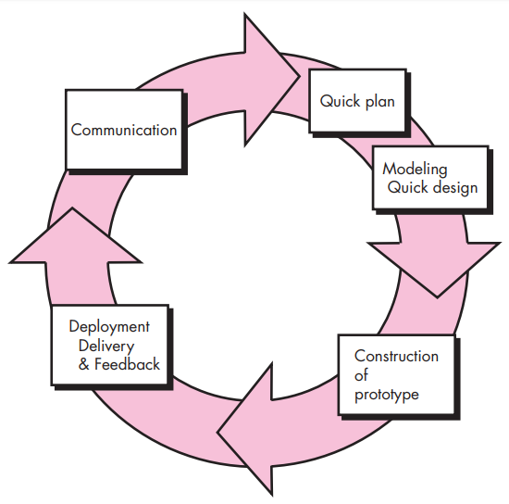
Sdlc: prototype model
The prototype model firstly a working prototype developed instead of developing actual software.
This is developed according to available requirements which basically have limited functions, low reliability while it passes through all stages of development.
This model is used by developer and given to user for review which help the user to better understand his needs and requirement and then feedback from users.

Slide 10
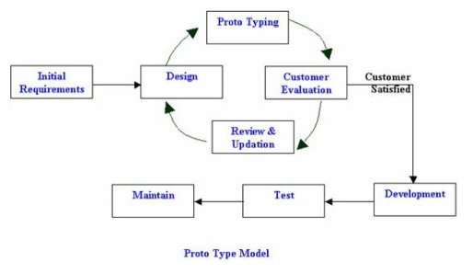
Prototype Model

Slide 11
Sdlc: spiral model
In 1987 the BOEHM proposed a model for development of software known as “Boehm Spiral Life cycle Model”.
According to its name the activity of this model are organize like spiral that has many circles whose number depends on software requirements.
The radial dimension of this model, the cumulative cost for accomplishing different stages and angular dimension show the progress in completing each cycle of the spiral.
The main objective of this model is to minimize the RISK through the use of prototype.

Slide 12
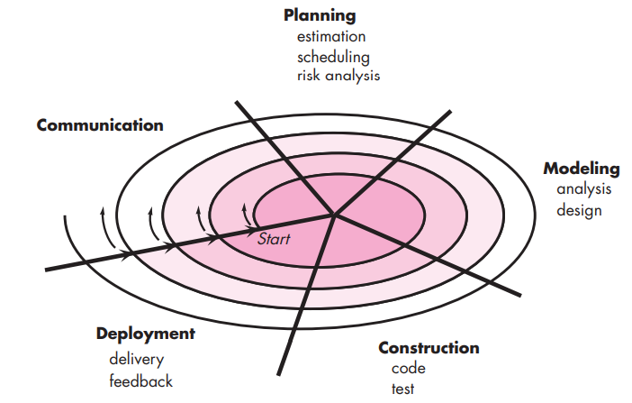
TYPICAL SPIRAL MODEL

Slide 13
SEGMENTS in spiral model
SEGMENT 1: Communication includes following activities: (requirement gathering, customer evaluation and understanding)
SEGMENT 2: Planning includes following activities: (estimation, scheduling and risk analysis)
SEGMENT 3: Modeling includes following activities: (analysis and design)
SEGMENT 4: Construction includes following activities: (coding and testing)
SEGMENT 5: Deployment includes following activities: (delivery and feedback)

Slide 14
Sdlc: evolutionary development model
This model is also known as Evolutionary Prototyping ,Simulated, Rapid Delivery cycle.
This model have many similarities with iterative enhancement model only one and most important difference is that it does not require a usable product at end of each cycle.
In this model it is not necessary that all end products should be usable as a particular software application can also be release in parts whose all parts when combined then only it work.
FOR EXAMPLE:
First cycle implementation GUI.
Second cycle implement file manipulation.
Third develop queries.

Slide 15
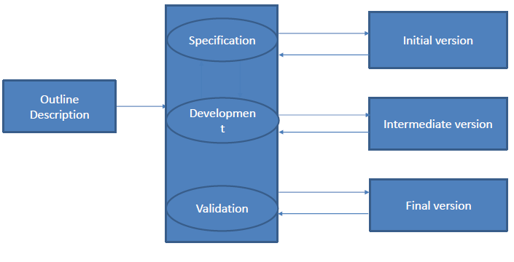
evolutionary development model

Slide 16
Sdlc: iterative enhancement model
Iterative model is developed to overcome the draw back of water fall model.
It is a combination of benefits of water fall model and prototype model. Very popular i.e. used by industries.
In this model software is developed in increments each increments add some functional capability to the system until full system is developed.
It provide better testing after each increment is easy as compare to entire model testing of water fall model and prototype.
In this model partial product is developed on few easily understandable requirements of overall requirements.

Slide 17
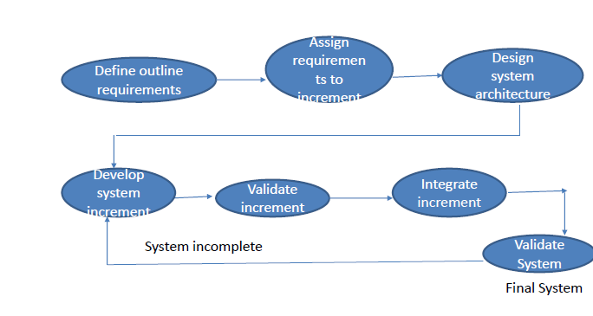
iterative enhancement model

Slide 18
Thank You!

